Slide 1
Chapter 10: Memory Interface

Slide 2
Introduction
Simple or complex, every microprocessor-based system has a memory system.
Almost all systems contain two main types of memory: read-only memory (ROM) and random access memory (RAM) or read/write memory.
This chapter explains how to interface both memory types to the Intel family of microprocessors.

Slide 3
Chapter Objectives
Upon completion of this chapter, you will be able to:
Decode the memory address and use the outputs of the decoder to select vari-ous memory components.
Use programmable logic devices (PLDs) to decode memory addresses.
Explain how to interface both RAM and ROM to a microprocessor.

Slide 4
Chapter Objectives
(cont.)
Upon completion of this chapter, you will be able to:
Explain how error correction code (ECC)
is used with memory.
Interface memory to an 8-, 16-, 32-, and
64-bit data bus.
Explain the operation of a dynamic RAM controller.
Interface dynamic RAM to the microprocessor.

Slide 5
10–1 MEMORY DEVICES
Before attempting to interface memory to the microprocessor, it is essential to understand the operation of memory components.
In this section, we explain functions of the
four common types of memory:
  read-only memory (ROM)
  Flash memory (EEPROM)
  Static random access memory (SRAM)
  dynamic random access memory (DRAM)

Slide 6
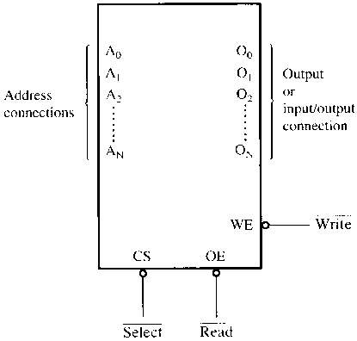
Figure 10–1 A pseudomemory component illustrating the address, data, and control connections.
Memory Pin Connections
  address inputs
  data outputs or input/outputs
  some type of selection input
  at least one control input to select a read or write operation

Slide 7
Address Connections
Memory devices have address inputs to
select a memory location within the device.
Almost always labeled from A₀, the least significant address input, to A_{n}
  where subscript n can be any value
  always labeled as one less than total number
  of address pins
A memory device with 10 address pins has
its address pins labeled from A₀ to A₉.

Slide 8
The number of address pins on a memory device is determined by the number of memory locations found within it.
Today, common memory devices have between 1K (1024) to 1G (1,073,741,824) memory locations.
  with 4G and larger devices on the horizon
A 1K memory device has 10 address pins.
  therefore, 10 address inputs are required to
  select any of its 1024 memory locations

Slide 9
It takes a 10-bit binary number to select any single location on a 1024-location device.
  1024 different combinations
  if a device has 11 address connections, it
  has 2048 (2K) internal memory locations
The number of memory locations can be extrapolated from the number of pins.

Slide 10
Data Connections
All memory devices have a set of data
outputs or input/outputs.
  today, many devices have bidirectional
  common I/O pins
  data connections are points at which data are entered for storage or extracted for reading
Data pins on memory devices are labeled D₀ through D₇ for an 8-bit-wide memory device.

Slide 11
An 8-bit-wide memory device is often called a byte-wide memory.
  most devices are currently 8 bits wide,
  some are 16 bits, 4 bits, or just 1 bit wide
Catalog listings of memory devices often refer to memory locations times bits per location.
  a memory device with 1K memory locations
  and 8 bits in each location is often listed as
  a 1K × 8 by the manufacturer
Memory devices are often classified according to total bit capacity.

Slide 12
Selection Connections
Each memory device has an input that selects or enables the memory device.
  sometimes more than one
This type of input is most often called a chip select (G2A) chip enable (CE) or simply select (S) input.
RAM memory generally has at least one or input, and ROM has at least one
If more than one CE connection is present,
all must be activated to read or write data.

Slide 13
Control Connections
All memory devices have some form of control input or inputs.
  ROM usually has one control input, while RAM often has one or two control inputs
Control input often found on ROM is the output enable or gate connection, which allows data flow from output data pins.
The OE connection enables and disables a set of three-state buffers located in the device and must be active to read data.

Slide 14
RAM has either one or two control inputs.
  if one control input, it is often called R/W
If the RAM has two control inputs, they are usually labeled WE (or W ), and OE (or G ).
  write enable must be active to perform memory write, and OE active to perform a memory read
  when the two controls are present, they must never both be active at the same time
If both inputs are inactive, data are neither written nor read.
  the connections are at their high-impedance state

Slide 15
ROM Memory
Read-only memory (ROM) permanently stores programs/data resident to the system.
  and must not change when power disconnected
Often called nonvolatile memory, because its contents do not change even if power is disconnected.
A device we call a ROM is purchased in mass quantities from a manufacturer.
  programmed during fabrication at the factory

Slide 16
The EPROM (erasable programmable read-only memory) is commonly used when software must be changed often.
  or when low demand makes ROM uneconomical
  for ROM to be practical at least 10,000 devices
  must be sold to recoup factory charges
An EPROM is programmed in the field on a device called an EPROM programmer.
Also erasable if exposed to high-intensity ultraviolet light.
  depending on the type of EPROM

Slide 17
PROM memory devices are also available, although they are not as common today.
The PROM (programmable read-only memory) is also programmed in the field by burning open tiny NI-chrome or silicon oxide fuses.
Once it is programmed, it cannot be erased.

Slide 18
A newer type of read-mostly memory
(RMM) is called the flash memory.
  also often called an EEPROM (electrically erasable programmable ROM)
  EAROM (electrically alterable ROM)
  or a NOVRAM (nonvolatile RAM)
Electrically erasable in the system, but they require more time to erase than normal RAM.
The flash memory device is used to store setup information for systems such as the video card in the computer.

Slide 19
Flash has all but replaced the EPROM in most computer systems for the BIOS.
  some systems contain a password stored
  in the flash memory device
Flash memory has its biggest impact in memory cards for digital cameras and memory in MP3 audio players.
Figure 10–2 illustrates the 2716 EPROM, which is representative of most common EPROMs.

Slide 20
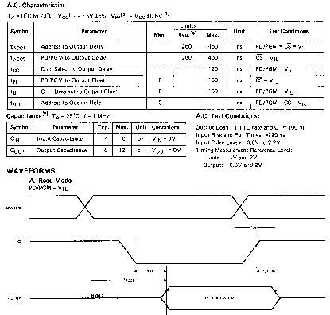
Figure 10–2 The pin-out of the 2716, 2K × 8 EPROM. (Courtesy of Intel Corporation.)

Slide 21
Figure 10–3 illustrates the timing diagram for the 2716 EPROM.
The V_{PP} pin must be placed at a logic 1 level for data to be read from the EPROM.
In some cases, the V_{PP} pin is in the same position as the WE pin on the SRAM.
This will allow a single socket to hold either
an EPROM or an SRAM.
  an example is the 27256 EPROM and 62256 SRAM, both 32K × 8 devices with the same pin-out, except for V_{PP} on the EPROM and WE on
  the SRAM.

Slide 22
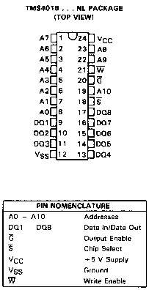
Figure 10–3 The timing diagram of AC characteristics of the 2716 EPROM. (Courtesy of Intel Corporation.)
  One important piece of information provided by the timing diagram and data sheet is the memory access time
  that is the time it takes the memory to read information

Slide 23
The basic speed of this EPROM is 450 ns.
  recall that 8086/8088 operated with a 5 MHz clock allowed memory 460 ns to access data
This type of component requires wait states
to operate properly with 8086/8088 because of its rather long access time.
  if wait states are not desired, higher-speed EPROMs are available at additional cost
  EPROM memory is available with access times
  of as little as 100 ns
Obviously, wait states are required in modern microprocessors for any EPROM device.

Slide 24
Static RAM (SRAM) Devices
Static RAM memory devices retain data for
as long as DC power is applied.
Because no special action is required to retain data, these devices are called static memory.
  also called volatile memory because they will
  not retain data without power
The main difference between ROM and RAM is that RAM is written under normal operation, whereas ROM is programmed outside the computer and normally is only read.

Slide 25
Fig 10–4 illustrates the 4016 SRAM,
  a 2K × 8 read/write memory
This device is representative of all SRAM devices.
  except for the number of address and data connections.
The control inputs of this RAM are slightly different from those presented earlier.
  however the control pins function exactly the same as those outlined previously
Found under part numbers 2016 and 6116.

Slide 26
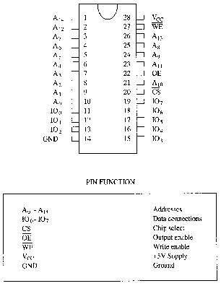
Figure 10–4 The pin-out of the TMS4016, 2K × 8 static RAM (SRAM). (Courtesy of Texas Instruments Incorporated.)
  SRAM is used when the size of the read/write memory is relatively small
  today, a small memory is less than 1M byte

Slide 27
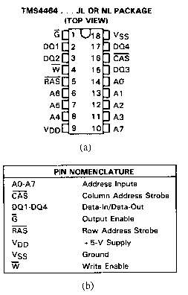
Figure 10–5 (a) The AC characteristics of the TMS4016 SRAM. (b) The timing diagrams of the TMS4016 SRAM. (Courtesy of Texas Instruments Incorporated.)
  the access time is t_{a(A)}
  on the slowest 4016, this time is 250 ns, fast enough to connect directly to an 8088/8086 at 5 MHz, without wait states
  access time must always be checked to determine compatibility of memory components

Slide 28
Figure 10–6 illustrates pin-outs of the 62256, 32K × 8 static RAM.
Packaged in a 28-pin integrated circuit
Available with access times of 120 or 150 ns.
Other common SRAM devices are
  8K × 8; 128K × 8; 256K × 8
  512K × 8; 1M × 8
Access times can be as low as 1.0 ns for SRAM used in computer cache memory.

Slide 29
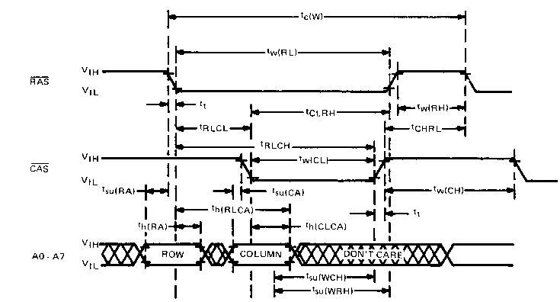
Figure 10–6 Pin diagram of the 62256, 32K × 8 static RAM.

Slide 30
Dynamic RAM (DRAM) Memory
Available up to 256M × 8 (2G bits).
DRAM is essentially the same as SRAM, except that it retains data for only 2 or 4 ms
on an integrated capacitor.
After 2 or 4 ms, the contents of the DRAM must be completely rewritten (refreshed).
  because the capacitors, which store a logic 1
  or logic 0, lose their charges

Slide 31
In DRAM, the entire contents are refreshed with 256 reads in a 2- or 4-ms interval.
  also occurs during a write, a read, or during a special refresh cycle
DRAM requires so many address pins that manufacturers multiplexed address inputs.
Figure 10–7 illustrates a 64K × 4 DRAM, the TMS4464, which stores 256K bits of data.
  note it contains only eight address inputs where
  it should contain 16—the number required to address 64K memory locations

Slide 32
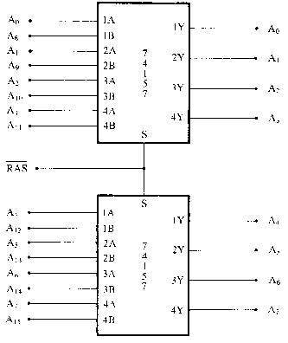
Figure 10–7 The pin-out of the TMS4464, 64K × 4 dynamic RAM (DRAM). (Courtesy of Texas Instruments Incorporated.)
  16 address bits can be forced into eight address pins in two 8-bit increments
  this requires two special pins: the column address strobe (CAS) and row address strobe (RAS)

Slide 33
First, A₀–A₇ are placed on the address pins and strobed into an internal row latch by RAS as the row address.
Next, address bits A₈-A₁₅ are placed on the same eight address inputs and strobed into an internal column latch by CAS as the column address
The 16-bit address in the internal latches addresses the contents of one of the 4-bit memory locations.
  CAS also performs chip selection input to DRAM

Slide 34
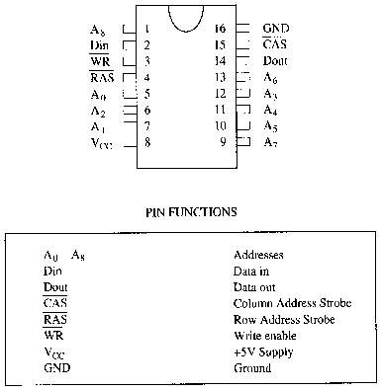
Figure 10–8 RAS, CAS and address input timing for the TMS4464 DRAM. (Courtesy of Texas Instruments Incorporated.)

Slide 35
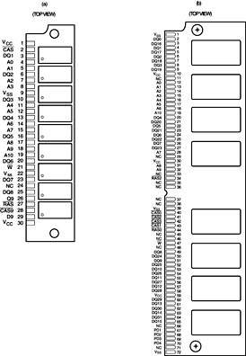
Figure 10–9 Address multiplexer for the TMS4464 DRAM.
  multiplexers used to strobe column and row addresses into the address pins on a pair of TMS4464 DRAMs.
  the RAS signal not only strobes the row address into the DRAMs, but it also selects which part of the address is applied to the address inputs.

Slide 36
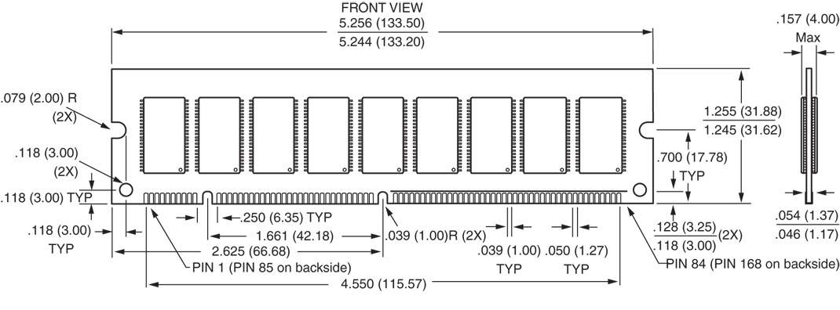
Figure 10–10 The 41256 dynamic RAM organized as a 256K × 1 memory device.
  the pin-out of the 41256 dynamic RAM
  this device is organized as a 256K × 1 memory
  requires as little as 70 ns to access data

Slide 37
DRAM is often placed on small boards called SIMMs (Single In-Line Memory Modules).
The 30-pin SIMM is organized most often as 1M × 8 or 1M × 9, and 4M × 8 or 4M × 9.
  illustrated in Fig 10–11 is a 4M × 9
  the ninth bit is the parity bit
Also shown is a newer 72 pin SIMM.
72-pin SIMMs are often organized as 1M × 32 or 1M × 36 (with parity).
Fig 10–11 illustrates a 4M × 36 SIMM, which
has 16M bytes of memory

Slide 38
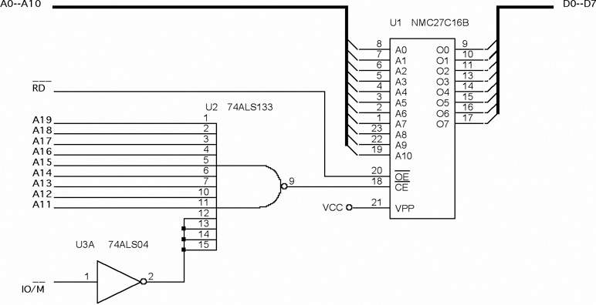
Figure 10–11 The pin-outs of the 30-pin and 72-pin SIMM. (a) A 30-pin SIMM organized as 4M × 9 and (b) a 72-pin SIMM organized as 4M × 36.

Slide 39
Pentium–Pentium 4 microprocessors have a 64-bit wide data bus, which precludes use of the 8-bit-wide SIMMs described here.
  72-pin SIMMs are cumbersome as they must be paired to obtain a 64-bit-wide data connection
64-bit-wide DIMMs (Dual In-line Memory Modules) have become the standard.
The memory on these modules is organized as 64 bits wide.
Common sizes available are from 16M bytes (2M × 64) to 1G bytes (128M × 64).

Slide 40
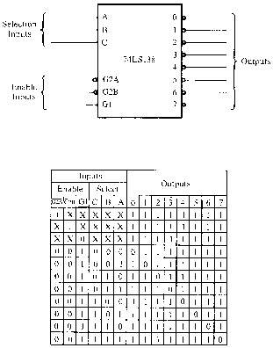
Figure 10–12 The pin-out of a 168-pin DIMM.
  The DIMM module is available in DRAM, EDO, SDRAM, and DDR (double-data rate) forms, with or without an EPROM.
  The EPROM provides information to the system on the size and the speed of the memory device for plug-and-play applications.

Slide 41
Another type is the RIMM memory module from RAMBUS Corporation,
  this memory type has faded from the market
The latest DRAM is the DDR (double-data rate) memory device and DDR2.
  DDR transfers data at each edge of the clock, making it operate at twice the speed of SDRAM
Many wait states are still required to operate this type of memory, but it can be much faster than normal SDRAM memory, including RDRAM.

Slide 42
10–2 ADDRESS DECODING
In order to attach a memory device to the microprocessor, it is necessary to decode
the address sent from the microprocessor.
Decoding makes the memory function at a unique section or partition of the memory map.
Without an address decoder, only one
memory device can be connected to a microprocessor, which would make it
virtually useless.

Slide 43
Why Decode Memory?
The 8088 has 20 address connections and
the 2716 EPROM has 11 connections.
The 8088 sends out a 20-bit memory
address whenever it reads or writes data.
  because the 2716 has only 11 address pins,
  there is a mismatch that must be corrected
The decoder corrects the mismatch by decoding address pins that do not connect
to the memory component.

Slide 44
Simple NAND Gate Decoder
When the 2K × 8 EPROM is used, address connections A₁₀–A₀ of 8088 are connected
to address inputs A₁₀–A₀ of the EPROM.
  the remaining nine address pins (A₁₉–A₁₁)
  are connected to a NAND gate decoder
The decoder selects the EPROM from one of the 2K-byte sections of the 1M-byte memory system in the 8088 microprocessor.
In this circuit a NAND gate decodes the memory address, as seen in Figure 10-13.

Slide 45
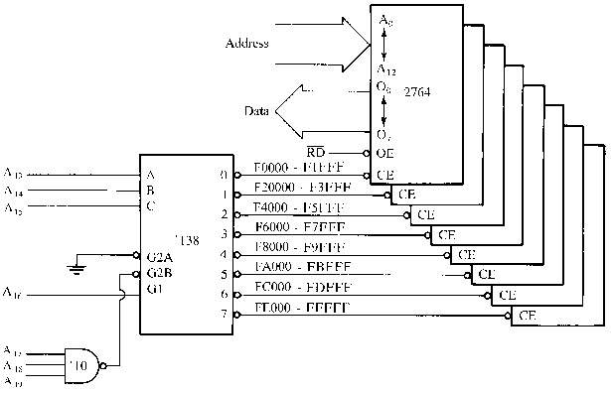
Figure 10–13 A simple NAND gate decoder that selects a 2716 EPROM for memory location FF800H–FFFFFH.

Slide 46
If the 20-bit binary address, decoded by the NAND gate, is written so that the leftmost nine bits are 1s and the rightmost 11 bits are don’t cares (X), the actual address range of the EPROM can be determined.
  a don’t care is a logic 1 or a logic 0, whichever
  is appropriate
Because of the excessive cost of the NAND gate decoder and inverters often required,
this option requires an alternate be found.

Slide 47
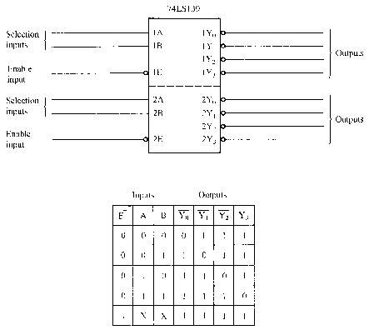
Figure 10–14 The 74LS138 3-to-8 line decoder and function table.
The 3-to-8 Line Decoder (74LS138)
  a common integrated circuit decoder found in many systems is the 74LS138 3-to-8 line decoder.

Slide 48
Sample Decoder Circuit
The outputs of the decoder in Figure 10–15, are connected to eight different 2764 EPROM memory devices.
The decoder selects eight 8K-byte blocks of memory for a total capacity of 64K bytes.
This figure also illustrates the address range of each memory device and the common connections to the memory devices.

Slide 49
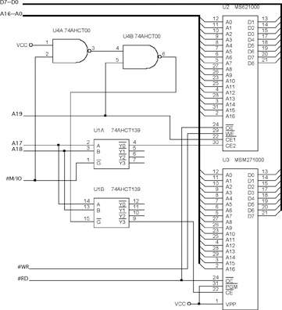
Figure 10–15 A circuit that uses eight 2764 EPROMs for a 64K × 8 section of memory in an 8088 microprocessor-based system. The addresses selected in this circuit are F0000H–FFFFFH.
  all address connections from the 8088 are connected to this circuit.
  the decoder’s outputs are connected to the CE inputs of the EPROMs,
  the RD signal from the 8088 is connected to the OE inputs of the
  EPROMs

Slide 50
In this circuit, a three-input NAND gate is connected to address bits A₁₉–A₁₇.
When all three address inputs are high, the output of this NAND gate goes low and enables input G2B of the 74LS138.
Input G1 is connected directly to A₁₆.
In order to enable this decoder, the first four address connections (A₁₉–A₁₆) must all be high.

Slide 51
Address inputs C, B, and A connect to microprocessor address pins A₁₅–A₁₃.
These three address inputs determine which output pin goes low and which EPROM is selected whenever 8088 outputs a memory address within this range to the memory system.

Slide 52
The Dual 2-to-4 Line Decoder (74LS139)
Figure 10–16 illustrates both the pin-out and the truth table for the 74LS139 dual 2-to-4
line decoder.
74LS139 contains two separate 2-to-4 line decoders—each with its own address, enable, and output connections.
A more complicated decoder using the 74LS139 decoder appears in Figure 10–17.

Slide 53
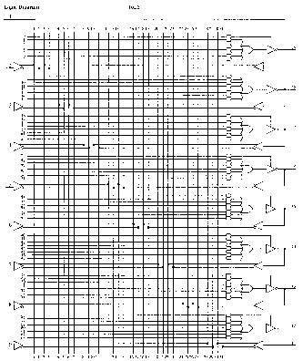
Figure 10–16 The pin-out and truth table of the 74LS139, dual 2-to-4 line decoder.

Slide 54
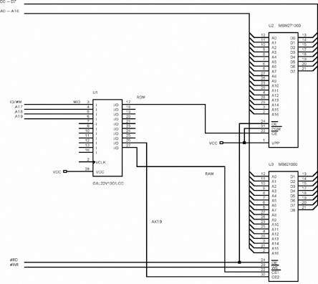
Figure 10–17 A sample memory system constructed with a 74HCT139.

Slide 55
PLD Programmable Decoders
Three SPLD (simple PLD) devices function in the same manner but have different names:
  PLA (programmable logic array)
  PAL (programmable array logic)
  GAL (gated array logic)
In existence since the mid-70s, they have appeared in memory system and digital designs since the early 1990s.

Slide 56
PAL and PLA are fuse-programmed, and some PLD devices are erasable devices.
  all are arrays of programmable logic elements
Other PLDs available:
  CPLDs (complex programmable logic devices)
  FPGAs (field programmable gate arrays)
  FPICs (field programmable interconnect)
These PLDs are more complex than the SPLDs used more commonly in designing
a complete system.

Slide 57
If the concentration is on decoding addresses, the SPLD is used.
If the concentration is on a complete system, then the CPLD, FPLG, or FPIC is used to implement the design.
These devices are also referred to as an ASIC (application-specific integrated circuit).

Slide 58
Combinatorial Programmable Logic Arrays
Fig 10–18 shows the internal structure of a PAL16L8 constructed with AND/OR gate logic.
It has 10 fixed inputs, two fixed outputs, and six pins programmable as inputs or outputs.
Programming is accomplished by blowing fuses to connect inputs to the OR gate array.
It is ideal as a decoder because of its structure, also because outputs are active low.

Slide 59
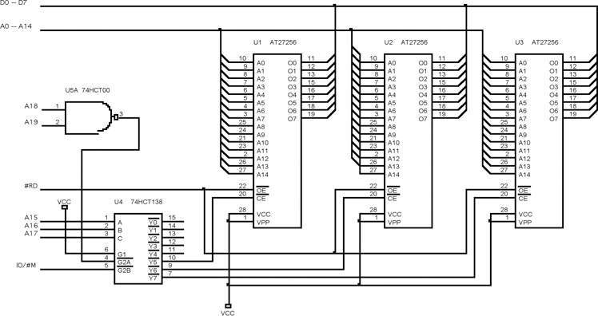
Figure 10–18 The PAL16L8. (Copyright Advanced Micro Devices, Inc., 1988. Reprinted with permission of copyright owner. All rights reserved.)

Slide 60
A PAL is programmed with software such
as PALASM, the PAL assembler program.
PLD design is accomplished using HDL (hardware description language) or
VHDL (verilog HDL).
  VHDL and its syntax are currently the industry standard for programming PLD devices
Various editors attempt to ease the task of defining the pins.
  the authors believe it is easier to use NotePad

Slide 61
Comments in VHDL begin with a pair of
minus signs as illustrated in the first line
of the VHDL code in Example 10–5.
  the library and use statements specify the standard IEEE library using standard logic
The entity statement names the VHDL module, in this case DECODER_10_17.
The port statements define the in, out, and in-out pins used in the equations for the logic expression, which appears in the begin block.

Slide 62
The architecture statement merely refers to the version (V₁) of this design.
Equations for the design are placed in the begin block.
  each output pin has its own equation
The keyword not is used for logical inversion and the keyword and is used for the logical and operation.
See Figure 10–19 for the PLD realization of Example 10–5.

Slide 63
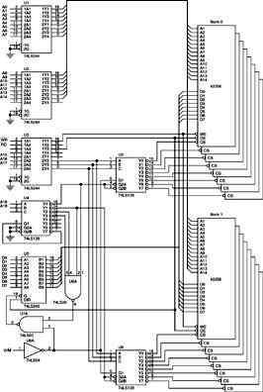
Figure 10–19 A RAM and ROM interface using a programmable logic device.
  the equation causes the ROM pin to become a logic zero only when the A₁₉, A₁₈, A₁₇, and MIO are all logic zeros (00000H–1FFFFH)
  the RAM equation causes the RAM pin to become a logic zero when A₁₈ and A₁₇ are all ones at the same time that MIO is logic zero
  RAM is selected for 60000H–7FFFFH

Slide 64
10–3 8088 and 80188 (8-bit) MEMORY INTERFACE
In this section, we examine the memory interface to both RAM and ROM and explain the error-correction code (ECC), which is still is currently available to memory system designers.
Many home computer systems do not use ECC because of the cost, but business machines often do use it.

Slide 65
Basic 8088/80188 Memory Interface
8088/80188 microprocessors have an 8-bit data bus, which makes them ideal to connect to common 8-bit memory devices available.
For the 8088/80188 to function correctly with memory, however, the system must decode the address to select a memory component.

Slide 66
Interfacing EPROM to the 8088
Fig 10–20 shows an 8088/80188 connected to three 27256 EPROMs, 32K × 8 devices.
  74HCT138 decoder in this illustration decodes three 32K × 8 blocks of memory for a total of 96K × 8 bits of physical address space for 8088/80188
The decoder is selected for an address range that begins at E8000H and continues through location FFFFFH—the upper 96K bytes of memory.

Slide 67
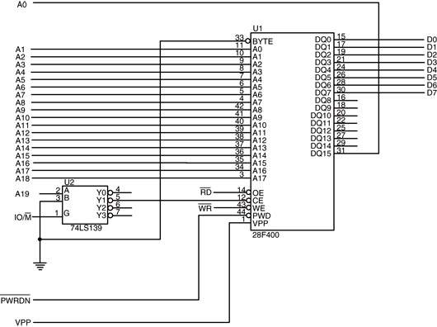
Figure 10–20 Three 27256 EPROMs interfaced to the 8088 microprocessor.

Slide 68
This section of memory is an EPROM because FFFF0H is where the 8088 starts to execute instructions after a hardware reset.
  often called the cold-start location
The software stored in this section of memory would contain a JMP instruction at location FFFF0H that jumps to location E8000H
  so the remainder of the program can execute
In this circuit, U₁ is decoded at addresses E8000H–EFFFFH, U₂ is decoded at F0000H–F7FFFH, and U₃ at F8000H–FFFFFH.

Slide 69
Interfacing RAM to the 8088
RAM is easier to interface than EPROM as most RAM does not require wait states.
  ideal section of memory for RAM is the very bottom, which contains vectors for interrupts
Interrupt vectors are often modified by software packages,
  it important to encode this section of the
  memory with RAM
Fig 10–21 shows sixteen 62256 static RAMs interfaced to the 8088, beginning at 00000H.

Slide 70
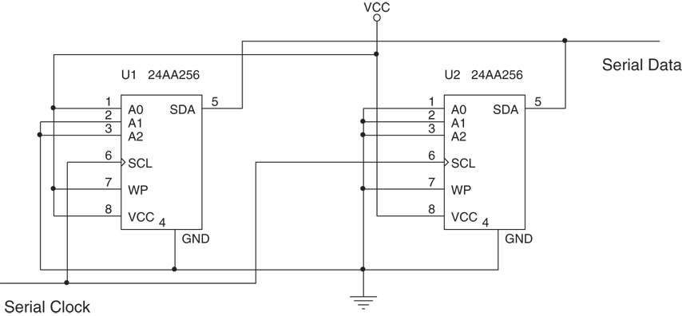
Figure 10–21 A 512K-byte static memory system using 16 62255 SRAMs.
  this board uses two decoders to select 16 RAM components, and a third to select other decoders for the appropriate memory sections
  sixteen 32K RAMs fill memory from 00000H through 7FFFFH, for 512K bytes memory.

Slide 71
Interfacing Flash Memory
Becoming commonplace for storing setup information on video cards, and the system BIOS in the personal computer.
  also in MP3 players and USB pen drives
Flash memory is also found in many other applications to store information that is only changed occasionally.

Slide 72
The difference between flash memory and SRAM is that flash requires 12V programming voltage to erase and write new data.
The newest versions of flash memory are erased with a 5.0V or even a 3.3V signal
  so a converter is not needed
EEPROM is available as a memory device with a parallel or serial interface.
Serial is too small for memory expansion, but as an I/O it can store information.
  such as in a flash drive.

Slide 73
Fig 10–22 shows a 28F400 flash memory interfaced to an 8088 parallel interface.
  28F400 can be used as a 512K × 8 memory device or as a 256K × 16 memory device
  because it is interfaced to an 8088, the configuration is 512K × 8
Control connections on this device are identical to that of an SRAM.
New pins are for erase and programming; selecting power-down mode when a logic 0; and selecting byte or word operation.

Slide 74
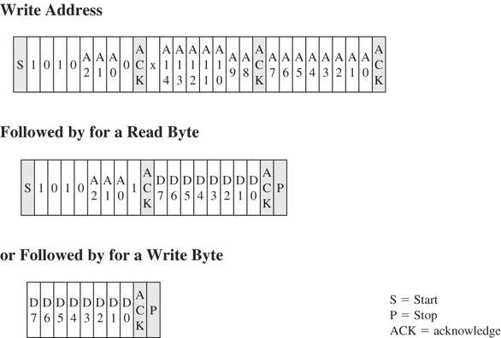
Figure 10–22 The 28F400 flash memory device interfaced to the 8088 microprocessor.

Slide 75
Most modern flash memory functions from 5V or 3.3V without need for higher programming voltage, and has a long life span.
  1,000,000 erases with storage time of 200 years
Fig 10–23 shows a small serial flash device.
  a 256K, organized as a 32K × 8 memory
The address pins are hardwired to allow more than one device to be placed on a serial bus.
A pull-up resistor is needed for serial use.
  the pull-up may be located in the microprocessor or it may need to be connected externally

Slide 76
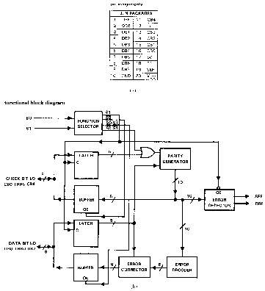
Figure 10–23 A serial EEPROM interface.
  this memory interface
  has two signal lines
  one is a serial clock (SCL); the other a bidirectional serial data line (SDA)
  not meant to replace system main memory
  it is fast enough for music or other low-speed data

Slide 77
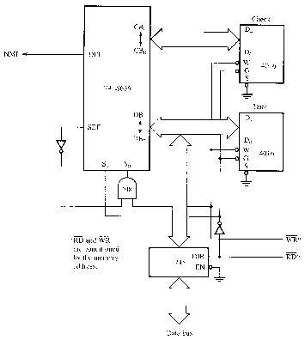
Figure 10–24 The data signals to the serial EEPROM for a read or a write.
  the serial data contains the address in the first byte as well as a device code of 1010, which represents the EEPROM
  other serial devices have different device codes
  this is followed by the memory location and the data in additional bytes

Slide 78
Error Correction
Integrated circuit manufacturers have only recently produced error-correcting circuits.
One such is the 74LS636, an 8-bit error correction and detection circuit that corrects any single-bit memory read error and flags
any 2-bit error called SECDED (single error correction/double error correction).
This device is found in high-end computer systems because of the cost of implementing a system that uses error correction.

Slide 79
Newest systems are now using DDR memory with ECC (error-correction code).
The 74LS636 corrects errors by storing five parity bits with each byte of memory data.
  automatic error correction for single-bit errors
If more than two bits are in error, this circuit may not detect it.
When a memory component fails completely, its bits are all high or all low.
In this case, the circuit flags the processor with a multiple-bit error indication.

Slide 80
Fig 10–25 depicts pin-outs of the 74LS636.
  it has eight data I/O pins
  five check bit I/O pins
  two control inputs (SO and SI)
  two error outputs: single-error flag (SEF) and double-error flag (DEF)
When a single error is detected, 74LS636 goes through an error-correction cycle.
It places a 01 on S₀ and S₁ by causing a wait and then a read following error correction.

Slide 81
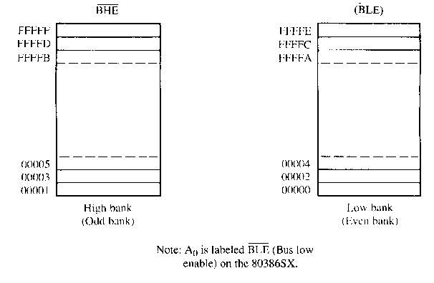
Figure 10–25 (a) The pin connections of the 74LS636. (b) The block diagram of the 74LS636. (Courtesy of Texas Instruments Incorporated.)

Slide 82
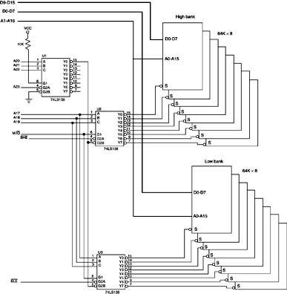
Figure 10–26 An error detection and correction circuit using the 74LS636.
  a circuit to correct single-bit errors with the 74LS636 and to interrupt the processor through the NMI pin for double-bit errors
  To simplify we depict only one 2K × 8 RAM and a second 2K × 8 RAM to store the 5-bit check code

Slide 83
Modern DDR error-correction memory (ECC) does not actually have logic circuitry on board that detects and corrects errors.
Since Pentium, the processor incorporates the logic to detect/correct errors provided the memory can store the extra 8 bits required
for storing the ECC code.
ECC memory is 72-bits wide using the additional 8 bits to store the ECC code.
If an error occurs, the microprocessor runs the correction cycle to correct the error.

Slide 84
Some memory devices such as Samsung memory also perform an internal error check.
The Samsung ECC uses 3 bytes to check every 256 bytes of memory, which is far
more efficient.
Additional information on the Samsung
ECC algorithm is available at the
Samsung website.

Slide 85
10–4 8086, 80186, 80286, & 80386SX (16-Bit) MEMORY INTERFACE
8086, 80186, 80286, and 80386SX differ from the 8088/80188 in three ways:
  the data bus is 16 bits instead of 8 bits wide
  the IO/M pin of the 8088 is replaced with an
  M/IO pin
  a new control signal called bus high enable
80286/80386SX contains a 24-bit address bus (A₂₃–A₀) instead of A 20-bit address bus (A₁₉–A₀) of the 8086/80186.

Slide 86
16-Bit Bus Control
The data bus of 8086, 80186, 80286, and 80386SX is twice as wide as for the 8088/80188.
  the wider bus presents a unique set of problems
  processors must be able to write data to any
  16-bit location—or any 8-bit location
This means the 16-bit data bus must be divided into two separate sections (or banks) 8 bits wide so that the processor can write to either half (8-bit) or both halves (16-bit).

Slide 87
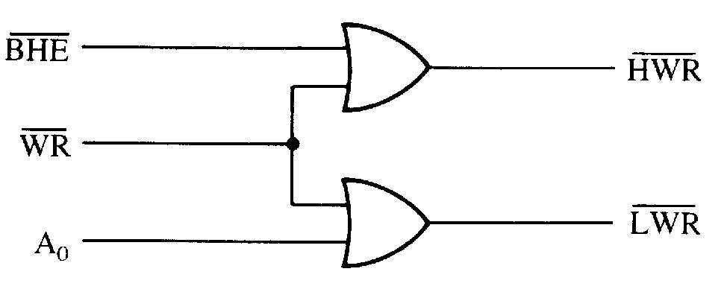
Figure 10–27 The high (odd) and low (even) 8-bit memory banks of the 8086/80286/80386SX microprocessors.
  one bank (low bank) holds all even-numbered memory locations
  the other bank (high bank) holds all the odd-numbered memory locations

Slide 88
Bank selection is accomplished in two ways:
  separate write signal is developed to select a write to each bank of the memory
  separate decoders are used for each bank
The first technique is by far the least costly approach to memory interface.
The second technique is only used in a system that must achieve the most efficient use of the power supply.

Slide 89
Separate Bank Decoders
Separate bank decoders is often the least effective way to decode memory addresses
for the 8086, 80186, 80286, and 80386SX.
This method is sometimes used, but it is difficult to understand why in most cases.
  one reason may be to conserve energy,
  as only banks selected are enabled
Fig 10–28 shows two 74LS138s used to
select 64K RAM memory components for the 80386SX microprocessor (24-bit address).

Slide 90
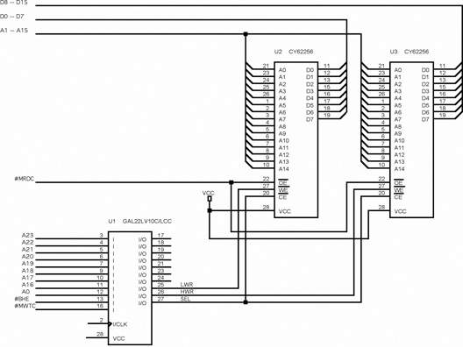
Figure 10–28 Separate bank decoders.

Slide 91
Separate Bank Write Strobes
The effective way to handle bank selection
is a separate write strobe for each bank.
  this requires only one decoder to select a 16-bit-wide memory, which saves money
Fig 10–29 depicts generation of separate
8086 write strobes.
Separate read strobes for each bank are usually unnecessary because 8086 through 80386SX read only the byte of data they need at any given time from half of the data bus.

Slide 92
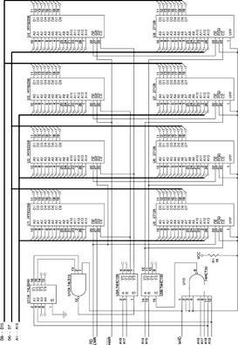
Figure 10–29 The memory bank write selection input signals: HWR (high bank write) and LWR (low bank write).
  a memory system that uses separate write strobes is constructed differently from the 8088 or the system using separate memory banks
  memory in a system using separate write strobes is decoded as 16-bit-wide

Slide 93
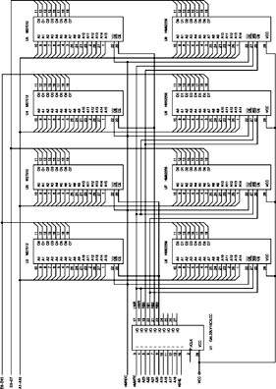
Figure 10–30 A 16-bit-wide memory interfaced at memory locations 06000H–06FFFH.
  a GAL22V10 to both decode memory and generate the separate write strobe
  the program for the GAL22V10 decoder is illustrated in Example 10–7
  notice that not only is the memory selected, but both the lower and upper write strobes
  are also generated by the PLD

Slide 94
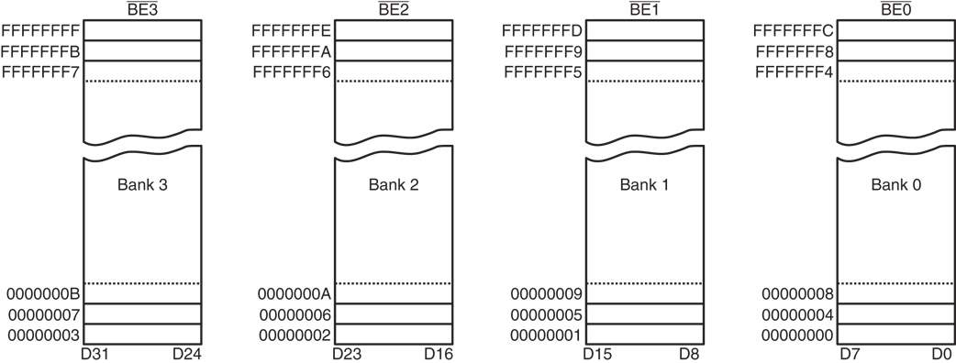
Figure 10–31 A memory system for the 8086 that contains a 64K-byte EPROM and a 128K-byte SRAM.
  four 27128 EPROMs compose a 32K × 16-bit memory at F0000–FFFFFH and four 62256 that compose 64K × 16-bit at 00000H–1FFFFH
  though 16 bits wide, it is still numbered in bytes

Slide 95
Fig 10–32 shows a memory connected to an 80386SX by using a GAL22V10 as a decoder.
This interface contains 256K bytes of EPROM in the form of four 27512 (64K × 8) EPROMs and 128K bytes of SRAM memory found in four 62256 (32K × 8) SRAMs.
The PLD decodes the 16-bit-wide memory addresses at locations 000000H–01FFFFH for the SRAM and locations FC0000H–FFFFFFH for the EPROM.

Slide 96
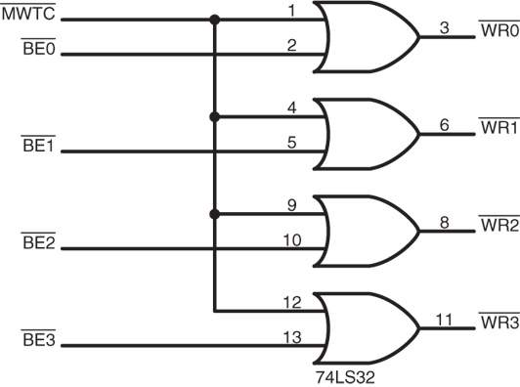
Figure 10–32 An 80386SX memory system containing 256K of EPROM and 128K of SRAM.

Slide 97
10–5 80386DX and 80486 (32-Bit) MEMORY INTERFACE
A 32-bit memory system has a 32-bit data
bus and four banks of memory.
Both 80386DX and 80486 (SX and DX) contain a 32-bit address bus that usually requires PLD decoders instead of integrated decoders.
  because of the sizable number of address bits

Slide 98
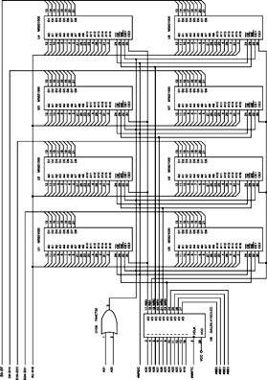
Figure 10–33 Memory organization for the 80386DX and 80486 microprocessors.
Memory Banks
  these large memory systems contain four 8-bit-wide banks that contain up to 1G byte
  bank selection is accomplished by bank selection signals BE3
  BE2, BE1 and BE0
  if a 32-bit number is transferred, all four banks are selected; if a 16-bit number, two banks; if 8 bits a single bank is selected.

Slide 99
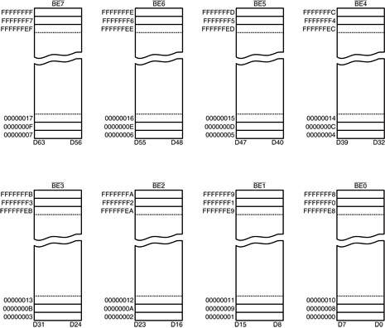
Figure 10–34 Bank write signals for the 80386DX and 80486 microprocessors.
  separate write strobes are developed, by using
  a simple OR gate or other logic component

Slide 100
32-Bit Memory Interface
A memory interface for 80386DX or 80486 requires four bank write strobes and decoding a 32-bit address.
  there are no integrated decoders, such as
  the 74LS138, that can easily accommodate a memory interface for the 80386DX or 80486
Figure 10–35 shows a 512K × 8 SRAM memory system for the 80486.
  This uses eight 64K × 8 SRAM memory
  devices, a PLD, and an OR gate

Slide 101
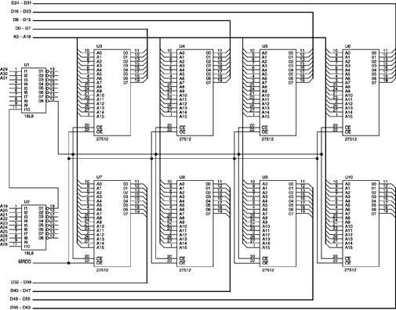
Figure 10–35 A small 512K-byte SRAM memory system for the 80486 microprocessor.

Slide 102
80386DX and 80486 microprocessors
operate with very high clock rates.
  usually require wait states for memory access
The interface provides a signal used with
the wait state generator.
Other devices with these higher speed microprocessors are cache memory and interleaved memory systems.

Slide 103
10–6 PENTIUM THROUGH CORE2 (64-Bit) MEMORY INTERFACE
The Pentium - Core2 contain a 64-bit data
bus, which requires eight decoders (one per bank) or eight separate write signals.
  except the P24T version of the Pentium
In most systems, separate write signals
are used when interfacing memory.
Figure 10–36 shows the Pentium memory organization and its eight memory banks.

Slide 104
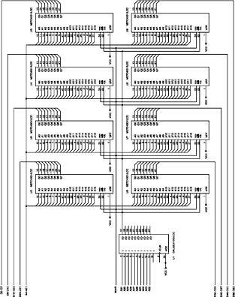
Figure 10–36 The memory organization of the Pentium–Core2 microprocessors.
  this is almost identical to
  80486, except it contains
  eight banks instead of four
  as with earlier versions, this organization is required for
  upward compatibility

Slide 105
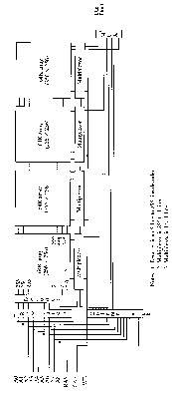
Figure 10–37 A small 512K-byte EPROM memory interfaced to the Pentium–Core2 microprocessors.
  separate write strobe signals
  are obtained by combining bank enable signals with the MWTC signal, generated by combining
  the M/IO with W/R
  the circuit employed for bank
  write signals is shown here
  a PLD is often used for bank
  write signal generation

Slide 106
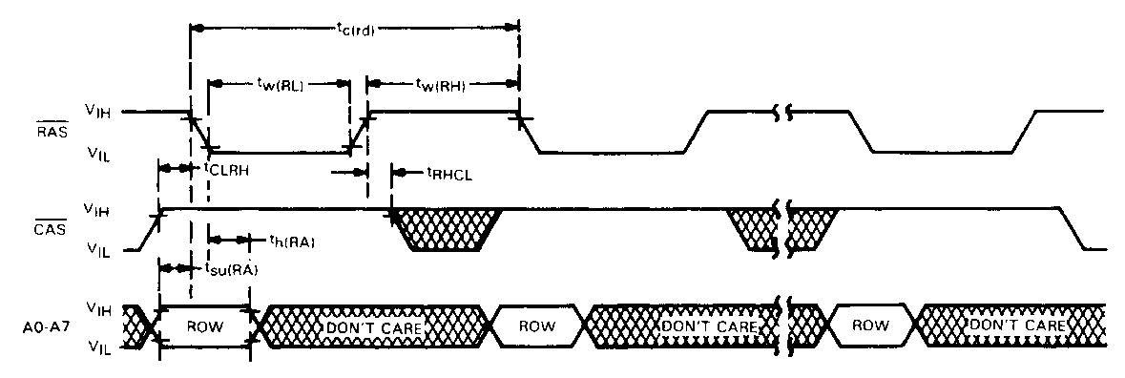
Figure 10–38 A small 4M-byte EPROM memory system for the Pentium–Core2 microprocessors.
64-Bit Memory Interface
  this system contains eight 27C4001 EPROM (512K × 8), at FFC00000H through FFFFFFFFH
  total memory size of 4M bytes organized so
  each bank contains two memory components

Slide 107
10–7 DYNAMIC RAM
Because RAM is often large, it requires many SRAMs at great cost or a few DRAMs (dynamic RAMs) at much reduced cost.
IC manufacturers have provided a dynamic RAM controller with address multiplexers
and timing circuitry necessary for refreshing.
This section of the text covers the DRAM
and provides information on the use of a dynamic controller in a memory system.

Slide 108
DRAM Revisited
DRAM must be refreshed periodically as it stores data internally on capacitors that lose charge in a short period of time.
  to refresh DRAM, contents of a section of the memory must periodically be read or written
Any read or write automatically refreshes an entire section of the DRAM.
The number of bits refreshed depends on the size of the memory component and its internal organization.

Slide 109
Refresh cycles are done with a read, write, or a special refresh that doesn’t read or write.
The refresh cycle is internal to the DRAM and often accomplished while other memory components in the system operate.
  this is called hidden refresh, transparent refresh, or sometimes, cycle stealing
To do a hidden refresh while other memory components are functioning, an RAS -only cycle strobes a row address into the DRAM
to select a row of bits to be refreshed.

Slide 110
The RAS input also causes the selected row to be read and rewritten into the selected bits.
  this recharges internal capacitors that store data
This refresh is hidden from the system because it occurs while the processor is reading or writing other sections of memory

Slide 111
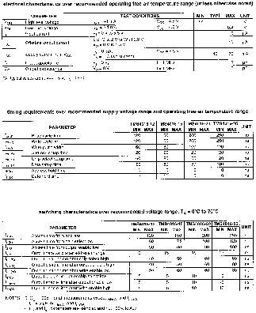
Figure 10–39 The internal structure of a 256K × 1 DRAM. Note that each of the internal 256 words are 1024 bits wide.
  DRAM internal organization has a series of rows and columns
  a 256K × 1 DRAM has 256 columns, each containing 256 bits, or rows organized into four sections of 64K bits
  When memory is addressed, the column address selects a column (or internal memory word) of 1024 bits

Slide 112
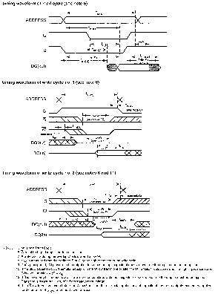
Figure 10–40 The timing diagram of the RAS refresh cycle for the TMS4464 DRAM. (Courtesy of Texas Instruments Corporation.)
  the difference between the RAS and a read or write is that it applies only a refresh address, usually obtained from a 7- or 8-bit binary counter.
  counter size is determined by type of DRAM being refreshed
  refresh counter is incremented at the end of each refresh cycle
  all rows are refreshed in 2 or 4 ms, depending on the DRAM

Slide 113
If there are 256 rows to be refreshed within 4 ms, the refresh cycle must be activated at least once every 15.6 µs.
  in a modern system such as a 3.0 GHz
  Pentium 4, 15.6 µs is a great deal of time
Since the 3.0 GHz Pentium 4 executes an instruction in about one-third ns, it can execute about 46,000 instructions
between refreshes.
In new machines much less than 1%
(≈0.002 %) is required for a refresh.

Slide 114
EDO Memory
Slight modification to the DRAM changes it an EDO (extended data output) DRAM device.
In EDO memory, any memory access, including a refresh, stores the 256 bits selected by RAS into latches.
This slight modification increases system performance by about 15% to 25%.
Although EDO memory is no longer available, the technique is employed in modern DRAM.

Slide 115
SDRAM
Synchronous dynamic RAM (SDRAM) is used with most newer systems because of speed.
Versions are available with access times as low as 7 ns, for the 133 MHz bus.
When a burst transfer occurs to the SDRAM from the processor, it takes three or four bus clocks before the first 64-bit number is read.
Each subsequent number is read without wait states and in one bus cycle each.

Slide 116
Because SDRAM bursts read four 64-bit numbers, the second through fourth require no waits, and can be read in one bus cycle each, SDRAM outperforms standard DRAM .
Most estimates place SDRAM at about a
10% performance increase over EDO memory.

Slide 117
DDR
Double-data rate (DDR) memory is the latest improvement in DRAM modifications.
  DDR memory data at double SDRAM speed because it transfers on each edge of the clock
  the positive edge is used for a transfer and so
  is the negative edge
Even though this seems as if it doubles the speed of the memory, it really does not.
  access time problems still exist, with even most advanced memory requiring access time of 40 ns.

Slide 118
DRAM Controllers
In most systems, a DRAM controller-IC performs address multiplexing and generation of the DRAM control signals.
  newer embedded processors, such as 80186/8, include refresh circuitry as part of the processor
Most modern computers contain the DRAM controller in the chip set so a stand-alone DRAM controller is not available.

Slide 119
The DRAM controller in the chip set for the microprocessor times refresh cycles and inserts refresh cycles into the timing.
The memory refresh is transparent to the microprocessor, because it really does not control refreshing.
For Pentium II, III, and P4, DRAM control is built in the chip set provided by Intel or AMD.
In the future, even the chip set will undoubtedly be built into the microprocessor.

Slide 120
SUMMARY
All memory devices have address inputs; data inputs and outputs, or just outputs; a pin for selection; and one or more pins that control the operation of the memory.
Address connections on a memory component are used to select one of the memory locations within the device.
Ten address pins have 1024 combinations and therefore are able to address 1024 different memory locations.

Slide 121
SUMMARY
(cont.)
Data connections on a memory are used to enter information to be stored in a memory location and also to retrieve information read from a memory location.
Manufacturers list their memory as, for example, 4K x 4, which means that the de-vice has 4K memory locations (4096) and that four bits are stored in each location.

Slide 122
SUMMARY
(cont.)
An EPROM memory is programmed by an EPROM programmer and can be erased if exposed to ultraviolet light.
Today, EPROMs are available in sizes from 1K x 8 up to 512K x 8 and larger.
The flash memory (EEPROM) is programmed in the system by using a 12 V or 5.0 V programming pulse.

Slide 123
SUMMARY
(cont.)
Static RAM (SRAM) retains data for as long as the system power supply is attached.
These memory types are available in sizes up to 128K x 8.

Slide 124
SUMMARY
(cont.)
Dynamic RAM (DRAM) retains data for only a short period, usually 2-4 ms.
This creates problems for the memory system designer because the DRAM must be refreshed periodically.
DRAMs also have multiplexed address inputs that require an external multiplexer
to provide each half of the address at the appropriate time.

Slide 125
SUMMARY
(cont.)
Memory address decoders select an EPROM or RAM at a particular area of the memory.
Commonly found address decoders include the 74LS138 3-to-8 line decoder, the 74LS139 2-to-4 line decoder, and programmed selection logic in a PLD.

Slide 126
SUMMARY
(cont.)
The access speed of the EPROM must be compatible with the microprocessor to which it is interfaced.
Many EPROMs available today have an access time of 450 ns, which is too slow for the 5 MHz 8088.
In order to circumvent this problem, a wait state is inserted to increase memory access time to 660 ns.

Slide 127
SUMMARY
(cont.)
Error-correction features are also available for memory systems, but these require the storage of many more bits.
If an 8-bit number is stored with an error-correction circuit, it actually takes 13 bits of memory: five for an error checking code and eight for the data.
Most error-correction integrated circuits are able to correct only a single-bit error.

Slide 128
SUMMARY
Dynamic RAM controllers are designed to control DRAM memory components.
Many DRAM controllers today are built
into the chip set and contain address multiplexers, refresh counters, and the circuitry required to do a periodic DRAM memory refresh.

